Slide 1


Designing a GraphQL schema

Slide 2
Why AZdev?
The API requirements for AZdev
Queries
Mutations
Subscriptions
Full schema text
Designing database models
Table of Contents

Slide 3
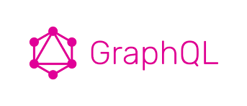
Designing a GraphQL schema
This lesson covers
Planning UI features and mapping them to API operations
Coming up with schema language text based on planned operations
Mapping API features to sources of data
Notes:
In this lesson, we are going to build a real data API for a real web application. I picked the name AZdev for it, which is short for “A to Z” of developer resources. AZdev will be a searchable library of practical micro-documentation, errors and solutions, and general tips for software developers.
I am not a fan of useless abstract examples that are removed from practical realities. Let’s build something real (and useful).

Slide 4
Why AZdev?
When software developers are performing their day-to-day tasks, they often need to look up one particular thing, such as how to compute the sum of an array of numbers in JavaScript.
AZdev is not a question-answer site. It is a library of what developers usually look up. It’s a quick way for them to find concise approaches to handle exactly what they need at the moment.
Notes:
They are not really interested in scanning pages of documentation to find the simple code example they need. This is why at AZdev, they will find an entry on “Calculate the sum of numbers in a JavaScript array” featuring multiple approaches on just that particular code-development need.
Here are some examples of entries I would imagine finding on AZdev:
Get rid of only the unstaged changes since the last Git commit
Create a secure one-way hash for a text value (like a password) in Node
A Linux command to lowercase names of all files in a directory
You can certainly find approaches to these needs by reading documentation and Stack Overflow questions, but wouldn’t it be nice to have a site that features specific tasks like these with their approaches right there, without all the noise?
AZdev is something I have wished existed for as long as I can remember. Let’s take the first step into making it happen. Let’s build an API for it!

Slide 5
Why AZdev?
The API requirements for AZdev
Queries
Mutations
Subscriptions
Full schema text
Designing database models
Table of Contents

Slide 6
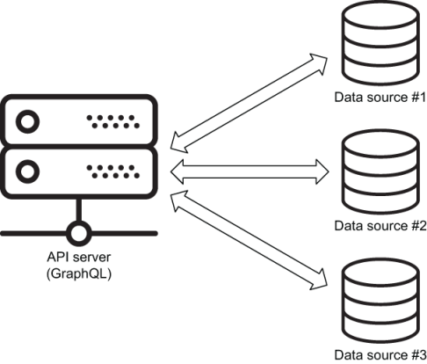
The API requirements for AZdev
Notes:
A great way to start thinking about a GraphQL schema is to look at it from the point of view of the UIs you’ll be building and what data operations they will require. However, before we do that, let’s first figure out the sources of data the API service is going to use. GraphQL is not a data storage service; it’s an interface to one or many
To make things interesting for the AZdev GraphQL API, we will have it work with two different data services. We’ll use a relational database service to store transactional data and a document database service to store dynamic data. A GraphQL schema can resolve data from many services, even in the same query!
It’s not at all unusual to have many sources of data in the same project. They don’t all have to be database services. A project can use a key-value cache service, get some data from other APIs, or even read data directly from files in the filesystem. A GraphQL schema can interface as many services as needed.
For the API vocabulary, let’s use the word Task to represent a single micro-documentation entry at AZdev and the word Approach for a single way or method to do that Task. A Task can have multiple Approaches. An Approach belongs to a Task.
NOTE
From now on, I will use the capitalized version of the words task and approach to refer to the database/API entities: for example, “Our first task is to create a Tasks table, and we will approach the Approaches table with some constraints in mind.”
NAMING ENTITIES IN A GRAPHQL SCHEMA
I am using simple names for the entities of this small API, but when you’re designing a big GraphQL API with entities that are related to multiple other entities, you should invest a little time when it comes to naming things.
This is general programming advice; but for GraphQL schemas, try to use specific names for your types when possible. For example, if you have a lesson that belongs to a course, name that type CourseLesson instead of just Lesson, even if the database model is named lessons. This is especially important if your GraphQL service is public. Your database schemas will evolve, and the types you use to describe their entities will need to evolve as well. You’ll need to deprecate types and introduce new ones. Specificity makes all that easier.
Anyone can browse AZdev and find Tasks and Approaches. Logged-in users can add new Tasks and Approaches, and they can also up-vote or down-vote Approaches.
AZdev’s main entries for both Tasks and Approaches will be stored in a relational database. I picked PostgreSQL for that. We’ll also store the User records in PostgreSQL. A relational database like PostgreSQL is great for, well, relations! A Task has many Approaches and is defined by a User.
NOTE
Why PostgreSQL? PostgreSQL is a scalable, open source, object-relational database that’s free to use and easy to set up. It offers an impressive set of advanced features that will be handy when you need them. It is one of the most popular choices among open source relational databases.
Extra data elements on Approaches like explanations, warnings, or general notes will be stored in a document database. I picked MongoDB for that. A document database like MongoDB is “schemaless,” which makes it a good fit for this type of dynamic data. An Approach might have a warning or an explanation associated with it, and it might have other data elements that we’re not aware of at the moment. Maybe at some point we will decide to add some performance metrics on Approaches or include a list of related links. We don’t need to modify a database schema for that; we can just instruct MongoDB to store these new data elements.
NOTE
Why MongoDB? MongoDB is the most popular open source document (NoSQL) database. The company behind it (MongoDB, Inc.) offers a community edition that is free to use and available on the three major operating systems.
TIP
This course will not be a proper source for you to learn these database services. However, the concepts we use in these services will be briefly explained, and all the commands and queries related to them will be provided as we progress through the API. I’ll also provide some sample data to help test the API features we add.

Slide 7
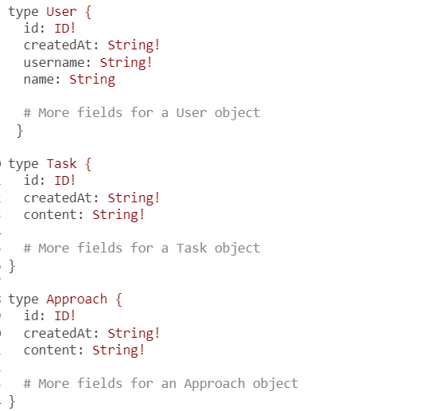
The core types
Notes:
The main entities in the API I’m envisioning for AZdev are User, Task, and Approach. These will be represented by database tables in PostgreSQL. Let’s make each table have a unique identity column and an automated creation date-time column.
In a GraphQL schema, tables are usually mapped to object types, and table columns are mapped to fields under these object types. I’ll use the term model to represent an entity in the API (a table represented by a GraphQL type), and I’ll use the term field to represent a property on an object under that model. Models are usually defined with upper camel-case (Pascal case), while fields are defined with lower camel-case (Dromedary case).
The User model will have fields to represent the information for a user. Let’s start with name and username.
Both the Task and Approach models will have a content field to hold their main text content. Here’s a schema language definition (SDL) that can be used to define the three core models in this API with their fields so far.
TIP
Open your code editor, type in the initial schema text in listing 4.1, and modify it as we progress through the analysis of the AZdev API. The rest of the SDL listings in this lesson will omit some existing parts of the schema for clarity.
Note that I defined the id field using the ID type. The ID type is special and means a unique identifier; it gets serialized as a String (even if the resolved values for it are integers). Using strings for IDs (instead of integers) is usually a good practice in JavaScript applications. The integer representation in JavaScript is limited.
Also note that I defined the createdAt “date” field as a String. GraphQL does not have a built-in format for date-time fields. The easiest way to work with these fields is to serialize them as strings in a standard format (like ISO/UTC).
Remember that the exclamation mark after the ID and String types indicates that these fields cannot have null values. Each record in the database will always have an id value and a createdAt value.
GRAPHQL TYPE MODIFIERS
The trailing exclamation mark is known as a type modifier because it modifies a type to be not null. Another type modifier is a pair of square brackets around the type (for example, [String]) to indicate that a type is a list of items of another type. These modifiers can also be combined. For example, [String!]! means a non-null list consisting of non-null string items. We’ll see an example of that shortly.
Note that if a field is defined with the type [String!]!, that does not mean the response of that field cannot be an empty array. It means it cannot be null.
If you want a field to always have a non-empty array, you can add that validation in its resolver’s logic or define a custom GraphQL type for it.
The id and createdAt fields are examples of how GraphQL schema types don’t have to exactly match the column types in your database. GraphQL gives you flexibility for casting one type from the database into a more useful type for the client. Try to spot other examples of this as we progress through the API.
NOTE
The object types in listing 4.1 are known as output types as they are used as output to operations, and also to distinguish them from input types, which are often used as input to mutation operations. We’ll see examples of input types later in this lesson.
WHERE IS THE PASSWORD FIELD?
Why is there no password field in the User type?
It’s important to remember here that we are not designing a database schema (yet); we are designing an API schema. Some GraphQL tools let you generate a database schema from a GraphQL API schema, but that limits the important differences between these two.
The password field should not be a readable part of the API schema. However, it will be part of the database schema (which we build in the next lesson).
Note that the password field will be part of the mutations to create or authenticate a user, as we will see later in this lesson.
This is a good start for the three core object types. We’ll add more fields to them as we discuss their relation to UI features. Let’s do that next.

Slide 8
Why AZdev?
The API requirements for AZdev
Queries
Mutations
Subscriptions
Full schema text
Designing database models
Table of Contents

Slide 9
Queries
Listing the latest Task records
Search and the union/interface types
Using an interface type
The page for one Task record
Entity relationships
The ENUM type
List of scalar values
The page for a user’s Task records
Authentication and authorization
Notes:
I like to come up with pseudo-code-style operations (queries, mutations, and subscriptions) that are based on the envisioned UI context and then design the schema types and fields to support these operations.
Let’s start with the queries.

Slide 10

Listing the latest Task records
query {
taskMainList {
id
content
# Fields on a Task object
}
}
Notes:
On the main page of AZdev, I would like to list the latest Task records. The GraphQL API has to provide a query root field to do that. This list will be limited to just the last 100 records, and it will always be sorted by the creation timestamp (newer first). Let’s name this field taskMainList.
Note that I named the root field taskMainList instead of a more natural name like mainTaskList. This is just a style preference, but it has an advantage: by putting the subject of the action (task, in this case) first, all actions on that subject will naturally be grouped alphabetically in file trees and API explorers. This is helpful in many places, but you can think about the autocomplete list in GraphiQL as an example. If you’re looking for what you can do on a Task model, you just type task, and all relevant actions will be presented in order in the autocomplete list. I’ll follow this practice for all queries, mutations, and subscriptions of every entity of this API.
A query root field is one that is defined directly under the Query type. Every GraphQL schema starts with its root fields. They are the entry points with which API consumers will always start their data queries.

Slide 11
Listing the latest Task records
To support the simple taskMainList query root field, here’s a possible schema design.
type Query {
taskMainList: [Task!]
# More query root fields
}
Notes:
The type for the new taskMainList is [Task!]. The square brackets modify the type to indicate that this field is a list of objects from the Task model. The resolver of this field will have to resolve it with an array. The exclamation mark after the Task type inside the square brackets indicates that all items in this array should have a value and that they cannot be null.
ROOT FIELD NULLABILITY
A general good practice in GraphQL schemas is to make the types of fields non-null, unless you have a reason to distinguish between null and empty. A non-null type can still hold an empty value. For example, a non-null string can be empty, a non-null list can be an empty array, and a non-null object can be one with no properties.
Only use nullable fields if you want to associate an actual semantic meaning with the absence of their values. However, root fields are special because making them nullable has an important consequence. In GraphQL.js implementations, when an error is thrown in any field’s resolver, the built-in executor resolves that field with null. When an error is thrown in a resolver for a field that is defined as non-null, the executor propagates the nullability to the field’s parent instead. If that parent field is also non-null, the executor continues up the tree until it finds a nullable field.
This means if the root taskMainList field were to be made non-null, then when an error is thrown in its resolver, the nullability will propagate to the Query type (its parent). So the entire data response for a query asking for this field would be null, even if the query had other root fields.
This is not ideal. One bad root field should not block the data response of other root fields. When we start implementing this GraphQL API in the next lesson, we will see an example.
This is why I made the taskMainList nullable, and it’s why I will make all root fields nullable. The semantic meaning of this nullability is, in this case, “Something went wrong in the resolver of this root field, and we’re allowing it so that a response can still have partial data for other root fields.”
Another way to implement the main Tasks list is to have a generic taskList root field and make that field support arguments to indicate any desired sorting and what limit to use. This is actually a more flexible option as it can be made to support many specific lists. However, flexibility comes with a cost. When designing a public API, it’s safer to implement the exact features of the currently envisioned UI and then optimize and extend the API according to the changing demands of the UI. Specificity helps in making better changes going forward.

Slide 12
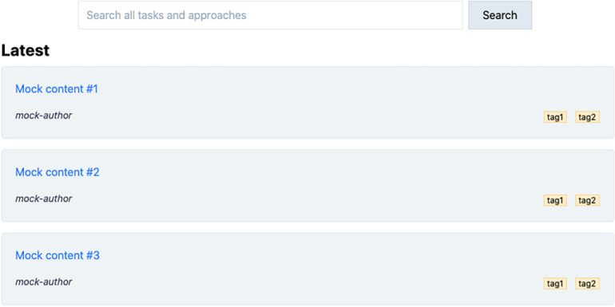
Search and the union/interface types
Notes:
The main feature of the AZdev UI is its search form. Users will use it to find both Task and Approach objects.
To support a search form, the GraphQL API should provide a query root field for it. Let’s name that field search.
The GraphQL type of this search root field is interesting. It has to perform a full-text SQL query to find records and sort them by relevance. Furthermore, that SQL query must work with two models and return a mixed list of matching Task and Approach objects, which may have different fields!
For example, in the UI, when the search result item is a Task record, let’s make it display how many Approach records it has; and when the search result item is an Approach record, let’s make it display the Task information for that Approach record.

Slide 13

Search and the union/interface types
To support that, we can simply add these new fields to the Task and Approach types.
type Task {
# ·-·-·
approachCount: Int!
}
type Approach {
# ·-·-·
task: Task!
}

Slide 14
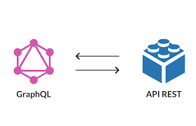
query {
search(term: "something") {
taskList {
id
content
approachCount
}
approachList {
id
content
task {
id
content
}
}
}
}
Notes:
However, the search root field cannot be a list of Task records or a list of Approach records. It has to group these two models under a new type. In GraphQL, you can model this grouping with either a union type or an interface type. I’ll tell you how to implement both of these types; but first, let’s understand why we need to group the two models in one list. Why not design the API to support a query like this?
This design works okay, but it has one major problem: it returns two different lists for search results. That means we cannot have an accurate rank of search results based on relevance. We can only rank them per set.
To improve this design, we have to return one list of all the objects matching the search term so that we can rank them based on relevance. However, since these objects can have different fields, we need to come up with a new type that combines them.
This design works okay, but it has one major problem: it returns two different lists for search results. That means we cannot have an accurate rank of search results based on relevance. We can only rank them per set.
To improve this design, we have to return one list of all the objects matching the search term so that we can rank them based on relevance. However, since these objects can have different fields, we need to come up with a new type that combines them.

Slide 15
Search and the union/interface types
search(term: "something") {
id
content
approachCount // when result is a Task
task { // when result is an Approach
id
content
}
}
Notes:
One approach to do that is to make the search root field represent an array of objects that can have nullable fields based on what model they belong to: for example, something like the following.
This is better, and it solves the rank problem. However, it’s a bit messy, as the API consumer will have to rely on knowing what fields are null to determine how to render search results.
GraphQL offers better solutions for this challenge. We can group search result items under either a union type or an interface type.

Slide 16

query {
search(term: "something") {
type: __typename
... on Task {
id
content
approachCount
}
... on Approach {
id
content
task {
id
content
}
}
}
}
Notes:
Using a union type
Remember that a union type represents OR logic (as discussed in lesson 3). A search result can be either a Task or an Approach. We can use the introspective __typename to ask the server what type a search result item is, and we can use inline fragments to conditionally pick the exact fields our UI requires based on the type of the returned item (just like we did for GitHub’s issueOrPullRequest example in lesson 3).
With a union implementation, this is the query a consumer can use to implement the search feature.
Note that this query is just a more structured version of the query in listing 4.6. The “when x is y” comment we had there is now an official part of the query, thanks to inline fragments, and the consumer knows exactly what type an item is thanks to the __typename introspective field.

Slide 17
Search and the union/interface types
In the GraphQL schema language, to implement this union type for the search root field, we use the union keyword with the pipe character (|) to form a new object type.
union TaskOrApproach = Task | Approach
type Query {
# ·-·-·
search(term: String!): [TaskOrApproach!]
}
Notes:
Note that I added parentheses after the search field to indicate that this field will receive an argument (the search term). Also note that a search result will always be an array, and any items in that array cannot be null. However, the array can be empty (when there are no matches).

Slide 18
query {
search(term: "something") {
type: __typename
id
content
... on Task {
approachCount
}
... on Approach {
task {
id
content
}
}
}
}
Using an interface type
Notes:
The query in listing 4.7 has a bit of duplication. Both the id and content fields are shared between the Task and Approach models. In lesson 3, we saw how shared fields can be implemented using an interface type.
Basically, we can think of a search item as an object that has three main properties (type, id, and content). This is its main interface. It can also have either an approachCount or a task field (depending on its type).
This means we can write a query to consume the search root fields, as follows.
There are no duplicated fields in this version, and that’s certainly a bit better. But how do we decide when to pick an interface over a union or the other way around?
I ask this question: “Are the models (to be grouped) similar but with a few different fields, or are they completely different with no shared fields?”
If they have shared fields, then an interface is a better fit. Only use unions when the grouped models have no shared fields.

Slide 19
interface SearchResultItem {
id: ID!
content: String!
}
type Task implements SearchResultItem {
# ·-·-·
approachCount: Int!
}
type Approach implements SearchResultItem {
# ·-·-·
task: Task!
}
type Query {
# ·-·-·
search(term: String!): [SearchResultItem!]
}
Using an interface type
Notes:
In the GraphQL schema language, to implement an interface type for the search root field, we use the interface keyword to define a new object type that defines the shared fields. Then we make all the models (to be grouped) implement the new interface type (using the implements keyword).
Besides the fact that the consumer query is simpler with an interface, there is a subtle reason why I prefer the interface type here. With the interface type, looking at the implementation of the Task/Approach types, you can easily tell they are part of another type. With unions, you cannot; you have to find what other types use them by looking at code elsewhere.
TIP
A GraphQL type can also implement multiple interface types. In SDL, you can just use a comma-separated list of interface types to implement.

Slide 20
The page for one Task record
The GraphQL API must provide a query root field to enable consumers to get data about one Task object.
Let’s name this root field taskInfo.
query {
taskInfo (
# Arguments to identify a Task record
) {
# Fields under a Task record
}
}
Notes:
Users of the AZdev UI can select a Task entry on the home page (or from search results) to navigate to a page that represents a single Task record. That page will have the record’s full information, including its list of Approaches.

Slide 21
The page for one Task record
To identify a single Task record, we can make this field accept an id argument.
Here is what we need to add in the schema text to support this new root field.
type Query {
# ·-·-·
taskInfo(id: ID!): Task
}
Notes:
Great. This enables API users to fetch full information about a Task object, but how about the information of the Approach objects that are defined under that Task object? How do we enable users to fetch these?
Also, because users of the AZdev application will be able to vote on Approaches, we should probably make the API return the list of Approaches sorted by their number of votes.

Slide 22
The page for one Task record
The simplest way to account for the number of votes on Approaches is to add a field to track how many current votes each Approach object has.
Let’s do that.
type Approach implements SearchResultItem {
# ·-·-·
voteCount: Int!
}
Notes:
Now, to return the list of Approaches related to a Task object, we need to talk about entity relationships.
TIP
Remember to always think of a GraphQL type in terms of what will be needed by the UI that’s going to use that type. It’s easy to add features when you need them. It’s a lot harder to remove them when you don’t.

Slide 23
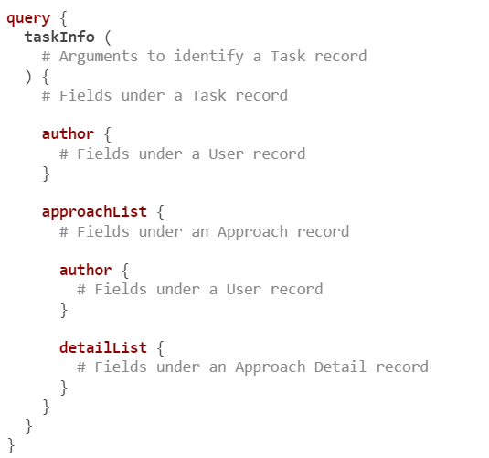
Entity relationships
Notes:
The list of Approaches under a Task object represents a relationship. A Task object can have many Approach objects.
There are a few other relationships that we have to support as well:
When displaying a Task record in the UI, we should display the name of the user who created it. The same applies to Approach objects.
For each Approach, the application will display its list of extra detail data elements. It’s probably a good idea to have a new Approach Detail object type to represent that relation.
We need to represent four relationships in this API:
A Task has many Approaches.
A Task belongs to a User.
An Approach belongs to a User.
An Approach has many Approach Detail records.
In the database, these relationships are usually represented with integers in identity columns (primary keys and foreign keys). The clients of this API are really interested in the data these IDs represent: for example, the name of the person who authored a Task record or the content of the Approaches defined on it. That’s why a client is expected to supply a list of leaf fields when they include these relation fields in a GraphQL query.
NOTE
I named the field representing the User relationship author. I’ve also named the list of detail records detailList instead of approachDetailList. The name of a field does not have to match the name of its type or database source.

Slide 24
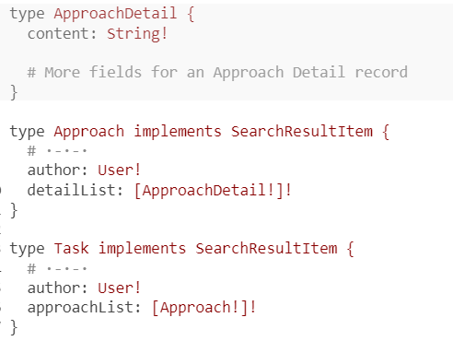
Entity relationships
Notes:
To support these relationships in the schema, we add references to their core types.
Note that I used the User type for the author field. We’ve also planned to use the same User type under the me field scope. This introduces a problem because of the taskList field that we need to define under the User type (see section 4.3.8). When a user is asking for their own Task records, that will work fine. However, when the API reports the author details of a public Task record, these details should not include the taskList of that author. We’ll figure out the solution to this problem as we implement the me field scope (in lesson 7).

Slide 25
The ENUM type
we can use GraphQL’s special ENUM type to represent them. Here is how to do that (in SDL).
enum ApproachDetailCategory {
NOTE
EXPLANATION
WARNING
}
Notes:
An Approach Detail record is just a text field (which I named content), but it is special because it will be under a particular category. We would like the API to support the initial set of categories NOTE, EXPLANATION, and WARNING. Since these three categories will be the only accepted values in an Approach Detail’s categories
The special ENUM type allows us to enumerate all the possible values for a field. Doing so adds a layer of validation around that field, making the enumerated values the only possible ones. This is especially helpful if you’re accepting input from the user for an enumerated field, but it’s also a good way to communicate through the type system that a field will always be one of a fixed set of values.

Slide 26
The ENUM type
Now we can modify the ApproachDetail GraphQL type to use this new ENUM type.
type ApproachDetail {
content: String!
category: ApproachDetailCategory!
}
Notes:
This is a good start for the GraphQL types we need to support the queries we are planning for the UI. It is, however, just a start. There are more fields to think about for the core types, and we may need to introduce more types as we make progress on the API.
NOTE
You should make API consumers paginate through list-type fields like taskMainList, search, approachList and detailList (under taskInfo), and taskList (under me). Never have the API return all records under a list. Check the official AZdev API source code for examples.

Slide 27
List of scalar values
Let’s make these tags part of the data response for each field that returns Task objects.
It can simply be an array of strings.
type Task implements SearchResultItem {
# ·-·-·
tags: [String!]!
}
Notes:
To make Task objects more discoverable, let’s enable API users to supply a list of tags when they create a Task object. A tag can be something like git, javascript, command, code, and so on.

Slide 28
The page for a user’s Task records
query {
me (
# Arguments to validate user access
) {
taskList {
# Fields under a Task record
}
}
}
Notes:
Let’s give logged-in users the ability to see the list of their Task records. We will name the field to support that taskList.
However, making taskList a root field might be confusing. It could be interpreted as a field to return a list of all Task records in the database!
We can name it differently to clear up that confusion, but another useful practice can also solve this issue. We can introduce a query root field representing the scope of the currently logged-in user and put the taskList field under it.
This field is commonly named me in GraphQL APIs, but that name is not a requirement. You can name it anything.
Any fields under the me field will be filtered for the currently logged-in user. In the future, we might add more fields under that scope. The me field is a good way to organize multiple fields related to the current user.

Slide 29
The page for a user’s Task records
To support the me { taskList } feature, we will have to introduce two fields in the schema: a root me field that returns a User type and a taskList field on the User type.
type User {
# ·-·-·
taskList: [Task!]!
}
type Query {
# ·-·-·
me: User
}
Notes:
NOTE
Once again, I made the me field nullable. A session might time out on the backend, but instead of returning a completely null response for a query that has a me field, we can return null for the timed-out me field and still include partial data in other parts of the query.
Great! A logged-in user can now ask for their own Task records. But how exactly will a user log in to the API, and how do we determine if a query request is from a logged-in user? This is a good place to talk about the concept of authentication (and authorization) in GraphQL.

Slide 30
Authentication and authorization
When an authToken is included with a request, the API server will use it to identify the user who is making that request, This token is similar in concept to a session cookie.
It will be remembered per user session and sent with GraphQL requests made by that session.
It should be renewed when users log in to the AZdev application.
Authorization is the business logic that determines whether a user has permission to read a piece of data or perform an action.
Notes:
The me field will require an access token. In this project, we’re going to use a simple string access token for authentication. I’ll refer to that token as authToken from now on. This string value will be stored in the database with a user record, and we can use it for personal query fields like me and search and some mutations as well.
TIP
A simple string value token is known as a bearer token. That label is often used in request headers to identify an authentication token.
WHAT ABOUT AUTHORIZATION?
For example, an authorization rule in the AZdev API could be, “Only the owner of a Task record can delete that record.”
The AZdev authToken value will make the server determine the API consumer’s identity, and that identity can then be used to enforce authorization rules.
We can include the authToken value in the GraphQL request text. For example, it can be a simple field argument. However, it’s a common practice to keep access tokens separate. For web APIs, request headers can be used to include such tokens.
It’s also a common practice to not do any authentication or authorization logic directly in field resolvers in a GraphQL API service and instead delegate those tasks to a higher layer, which should be the single source of truth for these concerns. For the AZdev API, that single source of truth can be the database. I’ll provide the SQL statements and point out any logic in them that’s crafted for authentication or authorization.
The authToken value is like a temporary password: it must be kept confidential in transit and in storage. Web applications should only send it over HTTPS connections, and it should not be stored in plain text in the database.
TIP
The string value token concept is the simplest thing we can do for authentication. If you’re interested in learning about more in-depth approaches to authentication and authorization, take a look at JSON Web Tokens (JWT). JWT uses JSON to carry certain common fields such as subject, issuer, expiration time, and so on. Along with related specs like JSON Web Signature (JWS) and JSON Web Encryption (JWE), JWT can be used to secure and validate token values. You can read more about JWT at az.dev/jwt.

Slide 31
Why AZdev?
The API requirements for AZdev
Queries
Mutations
Subscriptions
Full schema text
Designing database models
Table of Contents

Slide 32
Mutations
The GraphQL API will need to provide mutations to create a user and allow them to obtain an authorization token.
mutation {
userCreate (
# Input for a new User record
) {
# Fail/Success response
}
}
Notes:
To add content to AZdev (Tasks, Approaches, Details, Votes), a guest must create an account and log in to the application. This will require the API to host a users database table to store users’ credentials.

Slide 33
Mutations
mutation {
userLogin (
# Input to identify a User record
) {
# Fail/Success response
}
}
Notes:
The userCreate mutation will enable users to create an account for the AZdev application, and the userLogin mutation will enable them to perform future queries and mutations that are specific to them.
Note that for each mutation, I plan for handling a fail response as well as the normal success response. Mutations typically rely on valid user input to succeed. It’s a good idea to represent errors caused by invalid uses of mutations differently from other root errors a GraphQL API consumer can cause. For example, trying to request a nonexistent field is a root error. However, trying to create a user with a username that’s already in the system is a user error that we should handle differently.
PAYLOAD ERRORS
The root errors field is used for server problems (like 5xx HTTP codes), but it is also used for some client issues: for example, hitting the limit on a rate-limited API or accessing something without the proper authorization. GraphQL also uses that field if the client sends a bad request that fails the schema validation. The payload errors concept is suitable for user-friendly messages when users supply bad input.
Using user-friendly errors in payloads acts as an error boundary for the operation. Some developers even use payloads with errors in query fields. You can use them to hide implementation details and not expose server errors to the API consumer.
We can implement this fail/success response with either a union type or a special output payload type for each entity in the system. I’ll use the payload concept for the AZdev API mutations.

Slide 34
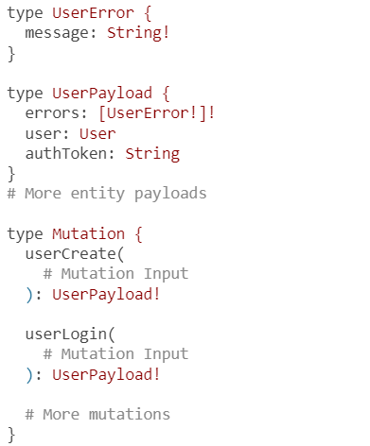
Mutations
For example, the userLogin mutation can include the generated authToken value as part of its output payload.
Here’s an example of how that can be done.
Notes:
A mutation output payload can include user errors, the entity on which that mutation operates, and any other values that might be useful for that mutation’s consumer.
Note that I kept the authToken field separate from the user field in the UserPayload type. I think this makes any use of the API cleaner. The authToken value is not really part of a User record; it’s just a temporary value for users to authenticate themselves for future operations. They will need to renew it at some point.
This takes care of the output of these two mutation operations. We still need to figure out the structure of their input.
TIP
I kept the UserError type simple, with just one required message field. This matches the structure of the GraphQL root errors array. I think it’s a good idea to also support the optional path and locations fields in this type to give API consumers more power to figure out what to do with these errors.

Slide 35
Mutation input
# Define an input type:
input UserInput {
username: String!
password: String!
firstName: String
lastName: String
}
# Then use it as the only argument to the mutation:
type Mutation {
userCreate(input: UserInput!): UserPayload!
# More mutations
}
Notes:
Mutations always have some kind of input that usually has multiple elements. To better represent and validate the structure of a multifield input, GraphQL supports a special input type that can be used to group scalar input values into one object.
For example, for the userCreate mutation, let’s allow the mutation consumer to specify a first name, last name, username, and password. All of these fields are strings.
Instead of defining four scalar arguments for the userCreate mutation, we can group these input values as one input object argument. We use the input keyword to do that.
A couple of things to note about this new type:
You can use any name for the input object type and the mutation argument. However, the names <Model>Input and input are the common conventions. I’ll use these conventions in the AZdev schema.
Making firstName and lastName optional allows a user to register an account with just their username (and password).
The UserInput type is similar to the core User type we designed for the queries for this API. So, why introduce a new input object type when we already have the core object type for a user?
Input object types are basically a simplified version of output object types. Their fields cannot reference output object types (or interface/union types). They can only use scalar input types or other input object types.
Input object types are often smaller and closer to the database schema, while object types are likely to introduce more fields to represent relations or other custom logic. For example, the id field is a required part of the User type, but we do not need it in the UserInput type because it’s a value that will be generated by the database. Some fields will appear in input object types but should not be in their corresponding output object types. An example is the password field. We need it to create a user account (or log in), but we should never expose it in any readable capacity.
While you can pass the username, firstName, and lastName values directly to the mutation, the input object type structure is preferable because it allows passing an object to the mutation. This often reduces the complexity of the code using that mutation and enhances code readability in general. Having an input object also adds a reusability benefit to your code.
TIP
Although the benefit of using an input object type relates to when you have multiple scalar input values, it’s a good practice to use the same pattern across all mutations, even those with a single scalar input value.

Slide 36
Mutations
For the userLogin mutation, we need the consumer to send over their username and password.
Let’s create an AuthInput type for that.
input AuthInput {
username: String!
password: String!
}
type Mutation {
# ·-·-·
userLogin(input: AuthInput!): UserPayload!
}

Slide 37
Deleting a user record
Let’s also offer AZdev API consumers a way to delete their user profile.
We will plan for a userDelete mutation to do that.
mutation {
userDelete {
# Fail/Success payload
}
}
Notes:
Note that this mutation does not have input. The user will be identified through their authToken value, which needs to be part of that request’s headers.

Slide 38
Deleting a user record
For a payload, we can just return the ID of the deleted user if the operation was a success.
Here’s the SDL text that represents this plan:
type UserDeletePayload {
errors: [UserError!]!
deletedUserId: ID
}
type Mutation {
# ·-·-·
userDelete: UserDeletePayload!
}

Slide 39
Creating a Task object
To create a new Task record in the AZdev application, let’s make the API support a taskCreate mutation.
Here’s what that mutation operation will look like.
mutation {
taskCreate (
# Input for a new Task record
) {
# Fail/Success Task payload
}
}
Notes:
To support this mutation, we need to define the Task input and payload types and create a new mutation field that uses them.
The input object’s main field is the simple text field for the content field on a Task record. There is also the tags field, which is an array of string values. Let’s also enable users to create private Tasks that are not to be included in the search (unless the user who is searching owns them).
TIP
Private Task entries will be handy for users to keep a reference of things they need in their private projects. Keep in mind that these entries will make things a bit more challenging since we need to exclude them, unless the API consumer is the user who owns them.

Slide 40
input TaskInput {
content: String!
tags: [String!]!
isPrivate: Boolean!
}
type TaskPayload {
errors: [UserError!]!
task: Task
}
type Mutation {
# ·-·-·
taskCreate(input: TaskInput!): TaskPayload!
}
Notes:
the SDL text that represents what we planned for the Task entity mutations.

Slide 41
Creating and voting on Approach entries
To create a new Approach record on an existing Task record, let’s make the API support an approachCreate mutation.
mutation {
approachCreate (
# Input to identify a Task record
# Input for a new Approach record (with ApproachDetail)
) {
# Fail/Success Approach payload
}
}
Notes:
A logged-in user viewing a Task record page along with the list of its mutations can up-vote or down-vote a single Approach record. Let’s make the API support an approachVote mutation for that. This mutation needs to return the new votes count for the voted-on approach.

Slide 42
Creating and voting on Approach entries
mutation {
approachVote (
# Input to identify an Approach record
# Input for "Vote"
) {
# Fail/Success Approach payload
}
}
Notes:
We’ll make that part of the Approach payload.

Slide 43
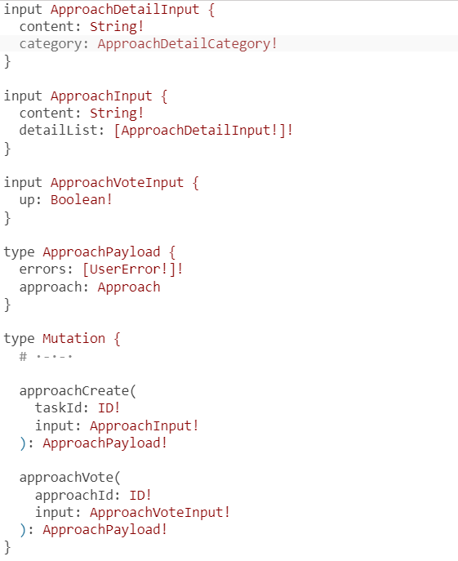
Here are the schema text changes needed to support these two new mutations.
Notes:
Note that I opted to represent up-votes and down-votes with a simple Boolean field and not an ENUM of two values. That’s an option when there are exactly two accepted values. It’s probably better to use an ENUM for this, but let’s keep it as a Boolean and add a comment to clarify it.

Slide 44
Creating and voting on Approach entries
We just put the comment text on the line before the field that needs it and surround that text with triple quotes (""").
input ApproachVoteInput {
"""true for up-vote and false for down-vote"""
up: Boolean!
}
Notes:
The clarifying text is known as a description in a GraphQL schema, and it is part of the structure of that schema. It’s not really a comment but rather a property of this type. Tools like GraphiQL expect it and display it in autocomplete lists and documentation explorers. You should consider adding a description property to any field that could use an explanation.
TIP
We should probably also support userUpdate and approachUpdate mutations. I’ll leave that as a multilesson exercise for you. In this lesson, you need to plan for how these mutations will be called and come up with the SDL text for them.
Note again that I am naming all the mutations using the form <model>Action (e.g., taskCreate) rather than the more natural action<Model> (e.g., createTask). Now all actions on a Task record are alphabetically grouped together. We’ll find the taskMainList, taskInfo, taskCreate, and taskUpdate operations next to each other.
TIP
The ApproachDetailInput type (listing 4.31) is identical to the ApproachDetail type (listing 4.17). However, don’t be tempted to reuse output object types as input object types. In the future, we might upgrade the Approach Detail concept to also have unique IDs and creation timestamps. There is also great value in keeping everything consistent.

Slide 45
Why AZdev?
The API requirements for AZdev
Queries
Mutations
Subscriptions
Full schema text
Designing database models
Table of Contents

Slide 46
Subscriptions
subscription {
voteChanged (
# Input to identify a Task record
) {
# Fields under an Approach record
}
}
Notes:
On Twitter and other social media apps, while you’re looking at a post, its counters for replies, shares, and likes are autoupdated. Let’s plan for a similar feature for the vote counts. While looking at the list of Approaches on the Task page, let’s make the votes autoupdate!
We can use a subscription operation to do that. This operation will have to accept a taskId input so that a user can subscribe to the vote changes on Approaches under a single Task object (rather than all Approaches in the system). Let’s name this subscription operation voteChanged.

Slide 47
Subscriptions
Let’s name this subscription operation taskMainListChanged.
subscription {
taskMainListChanged {
# Fields under a Task record
}
}
Notes:
On the AZdev home page, which shows the list of all the latest Tasks, another subscription-based feature that will add value is to show an indicator telling the user that new Task records are available. They can click that indicator to show the new Tasks.

Slide 48
Subscriptions
To support these subscriptions, we define a new Subscription type with the new fields under it, like this:
type Subscription {
voteChanged(taskId: ID!): Approach!
taskMainListChanged: [Task!]
}
Notes:
How does all that sound to you? Let’s make it happen!
NOTE
I will be adding more features to the AZdev API outside of this course, but we need to keep things simple and manageable here. You can explore the AZdev current production GraphQL API at az.dev/api and see what other queries, mutations, and subscriptions I have added.
Full schema text
Did you notice that I came up with the entire schema description so far just by thinking in terms of the UI? How cool is that? You can give this simple schema language text to the frontend developers on your team, and they can start building the frontend app right away! They don’t need to wait for your server implementation. They can even use some of the great tools out there to make a mock GraphQL server that resolves these types with random test data.
TIP
The schema is often compared to a contract. You always start with a contract.
The full schema text representing this course’s version of the AZdev GraphQL API can be found at az.dev/gia-schema.
TIP
I’ll repeat relevant sections of this schema text when we work through the tasks of implementing them.
With the GraphQL schema ready, let’s design a database schema to support it.

Slide 49
Why AZdev?
The API requirements for AZdev
Queries
Mutations
Subscriptions
Designing database models
Table of Contents

Slide 50
Designing database models
We have four database models in this project so far:
User, Task, and Approach in PostgreSQL
ApproachDetail in MongoDB
To create a PostgreSQL schema, you can use this command:
CREATE SCHEMA azdev;
Notes:
Let’s start with the User model in PostgreSQL. But before we do, it’s a good idea to create a schema in a PostgreSQL database to host an application’s tables rather than have them in the default public schema. This way, you will have the option to use the same PostgreSQL database to host data for many applications.
NOTE
A PostgreSQL schema has nothing to do with a GraphQL schema. It’s just a way to organize tables and views (and other objects) in a PostgreSQL database.
NOTE
You don’t have to execute any of the code listings in this section. In lesson 5, we will start with a project template that has all the SQL and NoSQL statements that you need for the entire AZdev project. I have also prepared database service containers that are ready with the models we’re going to design here. You can just download them and run them to prepare your environment with all database-related entities. However, I strongly recommend that you go over this section to be sure you understand all the database design decisions we are going to make.

Slide 51
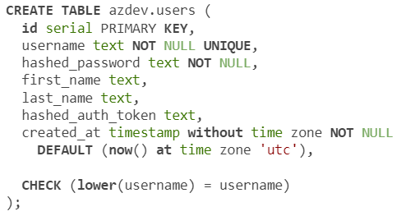
The User model
A SQL statement to create a table for the User model.
Notes:
The users database table will have a record for each registered user. Besides the unique ID and creation-time fields we’re adding under each model, a user record will have a unique username field and a hashed password field. These fields are required.
We’ve designed the GraphQL User type to have a name field. However, let’s design the database tables to have separate first- and last-name fields.
We need a mechanism to authenticate requests to the GraphQL API after a user logs in without having them send over their password each time. We’ll manage that with a column to store temporary authToken values (which should be hashed as well).
I gave the id field the serial type and the PRIMARY KEY constraint. The serial type will automatically fill this field using a sequence of integers (which is automatically created and managed for this table). The PRIMARY KEY constraint will make sure that values in this column are unique and not null. We’ll need the same id column definition in all tables as this column will be used for referential integrity constraints (making sure records reference existing records).
TIP
The username field is also unique and not null, making it practically another primary key. If you want to use the username as a primary key (and that’s not a bad idea), you just need to make sure any referential integrity constraints are updated correctly if the user decides to change their username. PostgreSQL has some advanced features to help with that.
The created_at field will be automatically populated by PostgreSQL, through the DEFAULT keyword. It will store the time each record was created in the UTC time zone. Neither the id nor the created_at field will be mutated by the GraphQL API; consumers can read them if they need to.
TIP
Keep it simple! I find it a lot easier to store date-time values without time zone information and always store UTC values. Life is too short to deal with time-zoned date-time values and their conversions.
The CHECK constraint on the username field validates that usernames are always stored in lowercase form. This is a good practice for fields that are unique regardless of their case. I’ve learned that the hard way.
The hashed_auth_token field is needed to authenticate requests to the GraphQL API after a user logs in. Because HTTP APIs are stateless, instead of having the user send over their password with every GraphQL operation, once they log in successfully, we will give them a temporary random string value to use in subsequent GraphQL requests, and the server will use that value to identify them. The hashed_auth_token value should be renewed per session, and we can come up with a way to invalidate it after a time.
TIP
There will always be more things you can do to make an API more secure, but for the purposes of this course, we will keep things simple while going with the practical minimum. For example, don’t ever store plain-text passwords or access tokens in your database! Even encrypting them is not secure enough. You should one-way hash them. That’s why I named these fields using the hashed_ prefix.
Note that I used snake-case (underscore separator) for PostgreSQL column names and not camel-case like GraphQL fields. PostgreSQL column names are case insensitive (unless you use quotes). So if we named the column createdAt, it would be converted to createdat. The snake-case style is the common convention in PostgreSQL, and it will add some challenges for us down the road when we need to map these columns to GraphQL camel-case fields.

Slide 52
The Task/Approach models
A SQL statement to create a table for the Task model.
Notes:
The tasks table will have a record for each Task object that’s submitted to the AZdev application. We designed a Task object to have a content text field, a list of tags, and an approachCount integer field. We’ll also need to add a field to support the isPrivate property, which we planned for in the mutation to create a new Task object.
A Task object can have many tags. We could come up with a new tags database table and introduce a new many-to-many relation to it, but let’s just store these tags as a comma-separated value for each Task record. Remember that GraphQL types don’t need to match their data source, so we can still make the GraphQL tags field be resolved as an array of strings.
TIP
PostgreSQL has an advanced feature to manage a list of items for a single row. A PostgreSQL column can have an array data type! I am using the comma-separated value to keep things simple, but feel free to experiment with that array data type and see how to deal with it once we start mapping PostgreSQL columns to GraphQL fields.
A Task (or Approach) record has to belong to a User record because only logged-in users can submit new entries. For that, we can use a FOREIGN KEY constraint to validate the map between a Task and a User. We’ll need to do the same for Approaches.
The approaches table will have a record for each Approach object submitted on a Task entry. We designed an Approach object to have a content text field and a voteCount integer field. Each Approach object must be stored under a valid User record and mapped to a Task record. This table will have two FOREIGN KEY constraint columns: user_id and task_id.

Slide 53
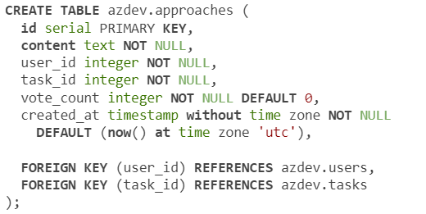
The Task/Approach models
A SQL statement to create a table for the Approach model.
Notes:
The tasks table will have a record for each Task object that’s submitted to the AZdev application. We designed a Task object to have a content text field, a list of tags, and an approachCount integer field. We’ll also need to add a field to support the isPrivate property, which we planned for in the mutation to create a new Task object.
A Task object can have many tags. We could come up with a new tags database table and introduce a new many-to-many relation to it, but let’s just store these tags as a comma-separated value for each Task record. Remember that GraphQL types don’t need to match their data source, so we can still make the GraphQL tags field be resolved as an array of strings.
TIP
PostgreSQL has an advanced feature to manage a list of items for a single row. A PostgreSQL column can have an array data type! I am using the comma-separated value to keep things simple, but feel free to experiment with that array data type and see how to deal with it once we start mapping PostgreSQL columns to GraphQL fields.
A Task (or Approach) record has to belong to a User record because only logged-in users can submit new entries. For that, we can use a FOREIGN KEY constraint to validate the map between a Task and a User. We’ll need to do the same for Approaches.
The approaches table will have a record for each Approach object submitted on a Task entry. We designed an Approach object to have a content text field and a voteCount integer field. Each Approach object must be stored under a valid User record and mapped to a Task record. This table will have two FOREIGN KEY constraint columns: user_id and task_id.

Slide 54
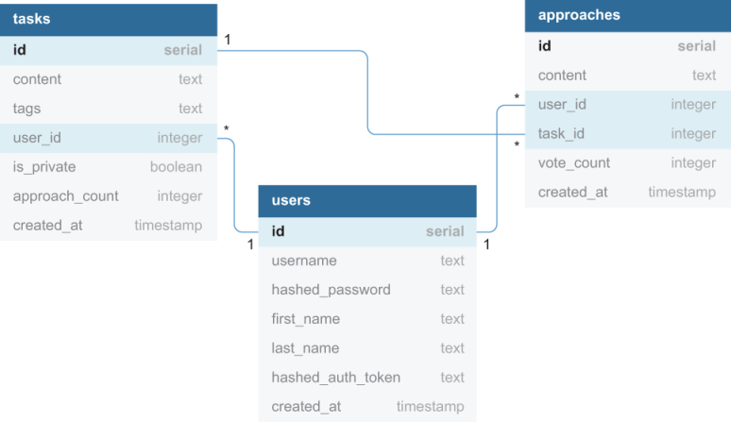
Notes:
summarizes these three tables and how they are related to each other.
Did you notice that I’ve used many database constraints like PRIMARY KEY, NOT NULL, UNIQUE, CHECK, and FOREIGN KEY? These database constraints will help future developers understand the design decisions we’re making today, and they will be the last-standing guard if a client tries to insert invalid data into the database. When it comes to data integrity, spare no layers! The least you can do is have the database validate it. Don’t skip that. You should also add more layers to give users of your API more meaningful error messages when they attempt to insert invalid data. We’ll do some data validation in the GraphQL layer as well.

Slide 55
The Approach Details model
You can run the following command to use a new database in a MongoDB client:
use azdev
Notes:
Since this is the first (and only) data model that we have in MongoDB, we first need to create a new MongoDB database for AZdev.
In MongoDB, there is no schema concept to group related database entities. You just create a database for that purpose. You actually don’t need to “create a database”; you just use it, and MongoDB automatically creates the currently used database the first time you insert any data into it.

Slide 56
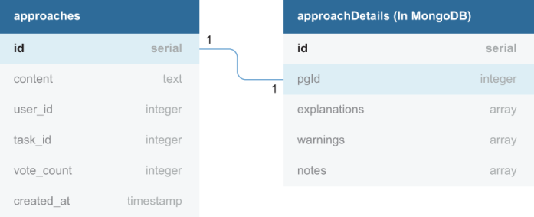
The Approach Details model
Notes:
A Model in MongoDB is represented with a Collection object, and-just like the database itself-you don’t need to create a collection. MongoDB will accept requests to store any data in any form or shape, regardless of whether a collection for it existed before. For new types of documents, MongoDB automatically creates new collections.
TIP
The flexibility in document databases is great, but it can also be a source of big problems. A simple typo might lead to having a brand-new (wrong) collection in the database. Be careful: with flexibility comes great responsibility!
You can create empty collections in MongoDB if you want, and you can also restrict the privileges of a database user to only perform certain actions on certain collections in certain databases! I think that’s a great way to validate that data will be stored in its intended locations. I’ll skip the privileges part here, but let’s plan the collection for the extra dynamic data elements that we want to support on Approaches.
MongoDB supports performing some data validation when inserting (or updating) documents in collections. This is useful when certain fields in your documents cannot be empty or must have a particular type or structure. For an Approach entry to have extra data elements in MongoDB, we need to associate its MongoDB record with its PostgreSQL ID to be able to do the mapping between the two sources

Slide 57
db.createCollection("approachDetails", {
validator: {
$jsonSchema: {
bsonType: "object",
required: ["pgId"],
properties: {
pgId: {
bsonType: "int",
description: "must be an integer and is required"
},
}
}
}
});
Notes:
Let’s use MongoDB schema validation to make sure we have that mapping for each Approach document. Here’s the MongoDB command you can use to create the approachDetails collection and define its validator that checks for the existence of a numeric pgId field.
This command creates an approachDetails collection. And because this is the first thing we’re creating in the currently used azdev database, the command also creates the database. You can verify that with the show dbs command. The show collections command should report back approachDetails.
Each Approach record will have a single record in the approachDetails collection. The Approach Detail record will have fields like explanations, warnings, notes, and other categories in the future. Each of these fields will have an array of text items. We’ll have to transform this special storage schema when resolving a GraphQL API request that asks for Approach Details.
TIP
Think of adding more tables and collections to the azdev database. For example, maybe store vote records and track who voted what and when. I’ll leave that as an exercise for you if you want to expand the scope of this API and make it more challenging.

Slide 58
Summary
An API server is an interface to one or many data sources.
GraphQL is not a storage engine; it’s just a runtime that can power an API server.
An API server can talk to many types of data services.
Data can be queried from databases, cache services, other APIs, files, and so on.s
Notes:
A good first step when designing a GraphQL API is to draft a list of operations that will theoretically satisfy the needs of the application you’re designing. Operations include queries, mutations, and subscriptions.
Relational databases (like PostgreSQL) are a good fit to store relations and well-defined, constrained data. Document databases (like MongoDB) are great for dynamic data structures.
Draft GraphQL operations can be used to design the tables and collections in databases and to come up with the initial GraphQL schema language text.
You should utilize the powerful data-integrity constraints and schema validators that are natively offered by database services.

Slide 59

"Complete Lab"

